Slide 1
Hunt the Wumpus (or die)
Team 4:
Alexis, Jeff, Robert

Slide 2
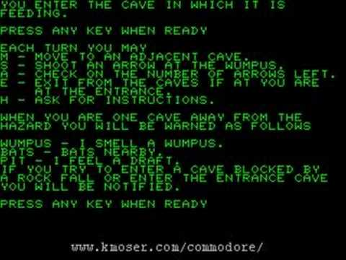
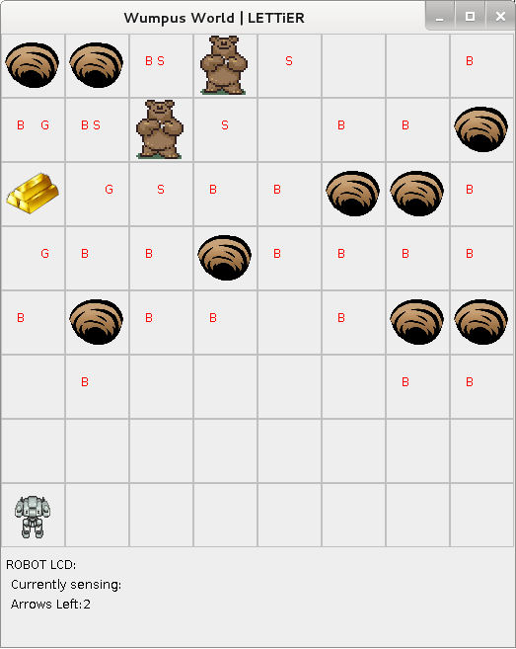
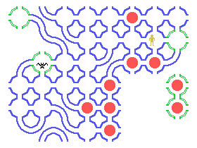

Slide 3
Requirements
There is a maze and 2 characters: the Player (you) and the Wumpus (computer)
Wumpus & Player are set on opposite ends of the maze.
Player & Wumpus take turns moving 1 block.
Player & Wumpus can move in any cardinal direction not including the block they came from.
Win: Player wins the game if they move into the block that contains the Wumpus
Loss: Player loses the game if the Wumpus moves into the block that they are in.
Difficulty Breakdown:
Easy: Wumpus gets 1 move for every 2 moves the player gets.
Hard: Wumpus gets 1 move for every 1 move the player gets.

Slide 4
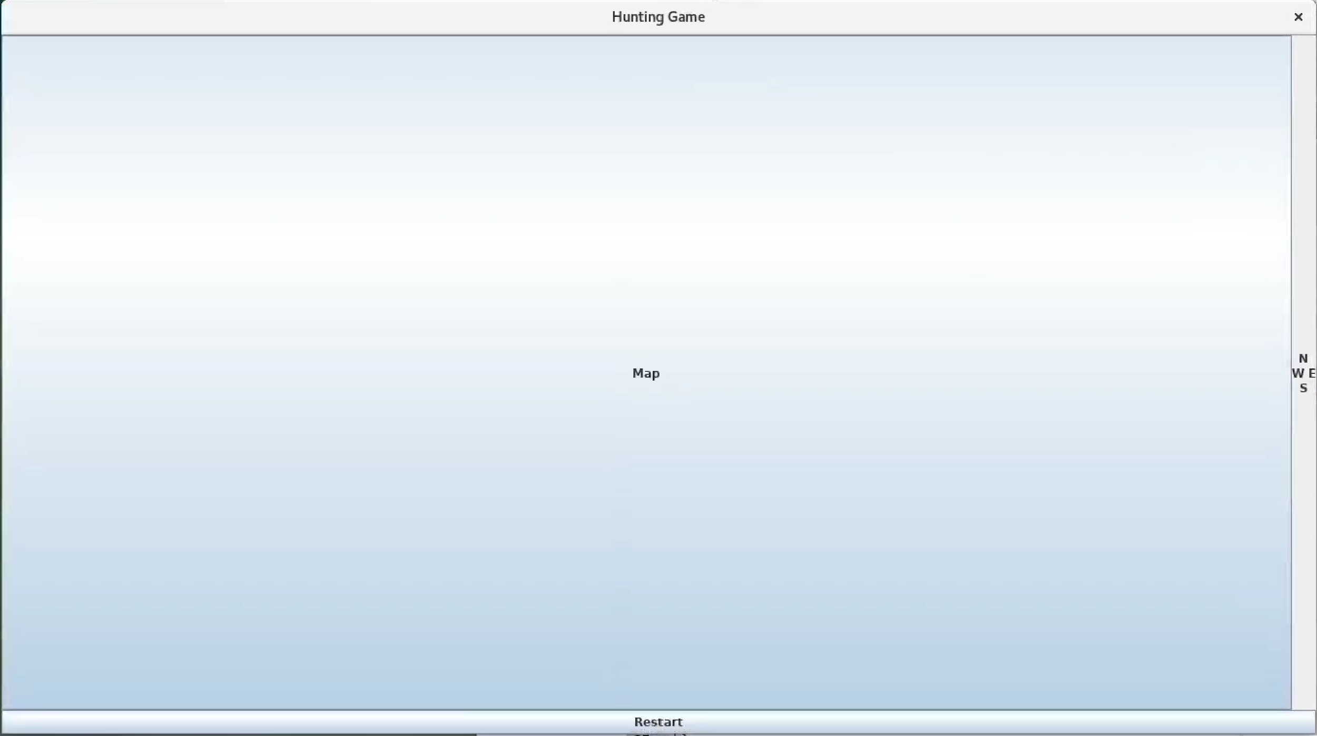
Original Prototype:

Slide 5
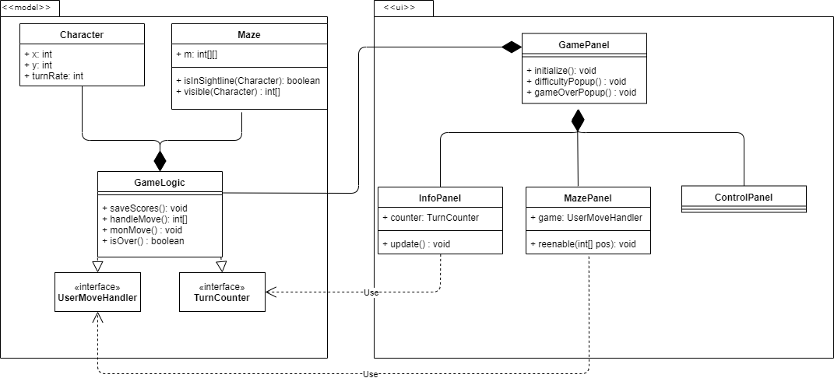
UML Diagram

Slide 6
Project Use Cases
User starts the application - High scores are loaded from file
UI elements are initialized, Game options (difficulty levels) are shown to the user
User chooses difficulty - Action listener detects option chosen,
Puzzle/Characters are configured, and UI displays selected board size/character vision/etc
User starts a game - Turn counter starts, Turn counter and current high-score is shown, and start position and vision is shown
User selects a direction- Action listener detects keypress, Model checks whether the direction is available,
Game moves selected piece to empty spot, or does nothing, depending on eligibility,
determine whether the game is over (win-state), determine if it’s the monster’s turn, determine player is in monster’s sight-line,
If monster sees player, monster moves towards player, if not, move in a random direction
Determine if the game is over (fail-state).
The user finishes the game - The number of turns taken is displayed, If won, scores are checked against high score by difficulty and high score is updated if necessary, new high scores are saved to file, and User is prompted for a new game

Slide 7
Design Patterns and Principles
Interface Segregation Principle - UserHandler and Turn Counter interfaces
Liskov Substitution Principle - Observable, MazePanel, MazeButton
Open-Closed Principle - Difficulty setting
Single Responsibility Principle - Violated since majority of methods in GameLogic and GamePanel

Slide 8
Unit Testing
Tested GameLogic and Maze
Most errors in GameLogic.handleMove() and Maze.visible()
These functions and tests were rewritten multiple times
Issues testing save/load high scores
UI Elements were not unit tested
Revealed logic errors
Issues with Observer/observable updating.
Null Pointer Errors

Slide 9
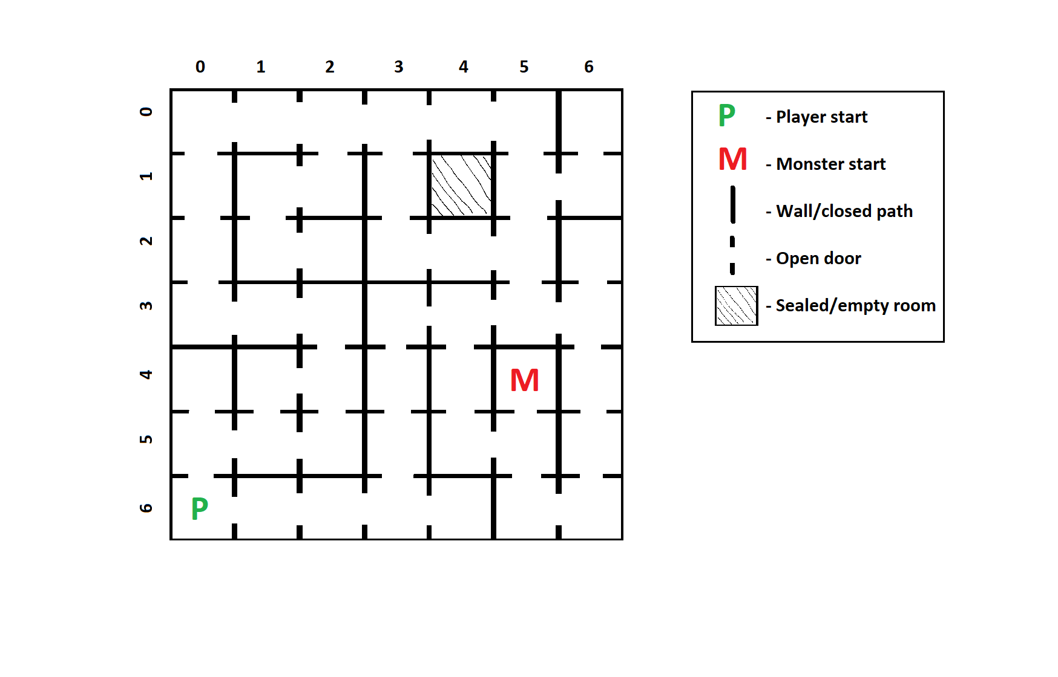
Demo:

Slide 10
Improvements:
Readability
Graphics
Change line of sight
Gameplay
Add keyboard input
More spawn locations
More than one maze

Slide 11
Questions?

